Slide 1



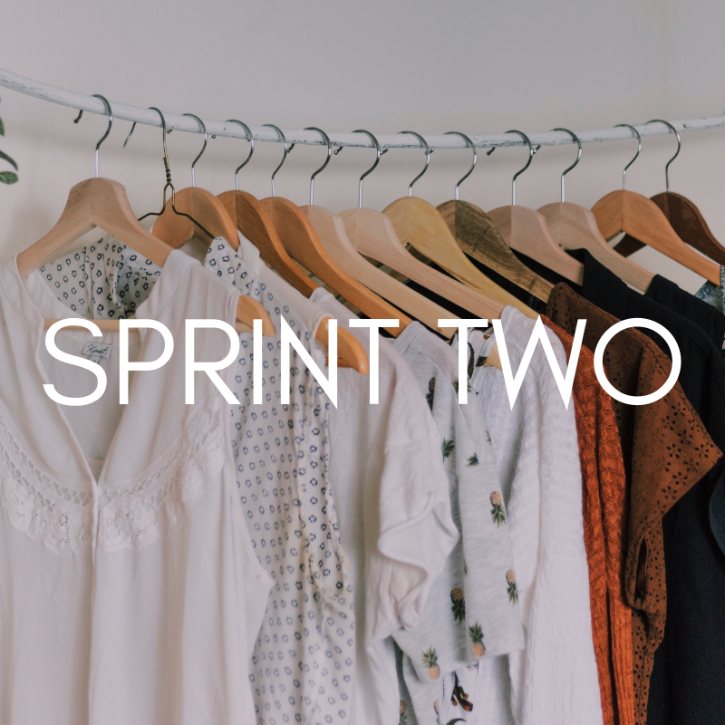

Slide 2

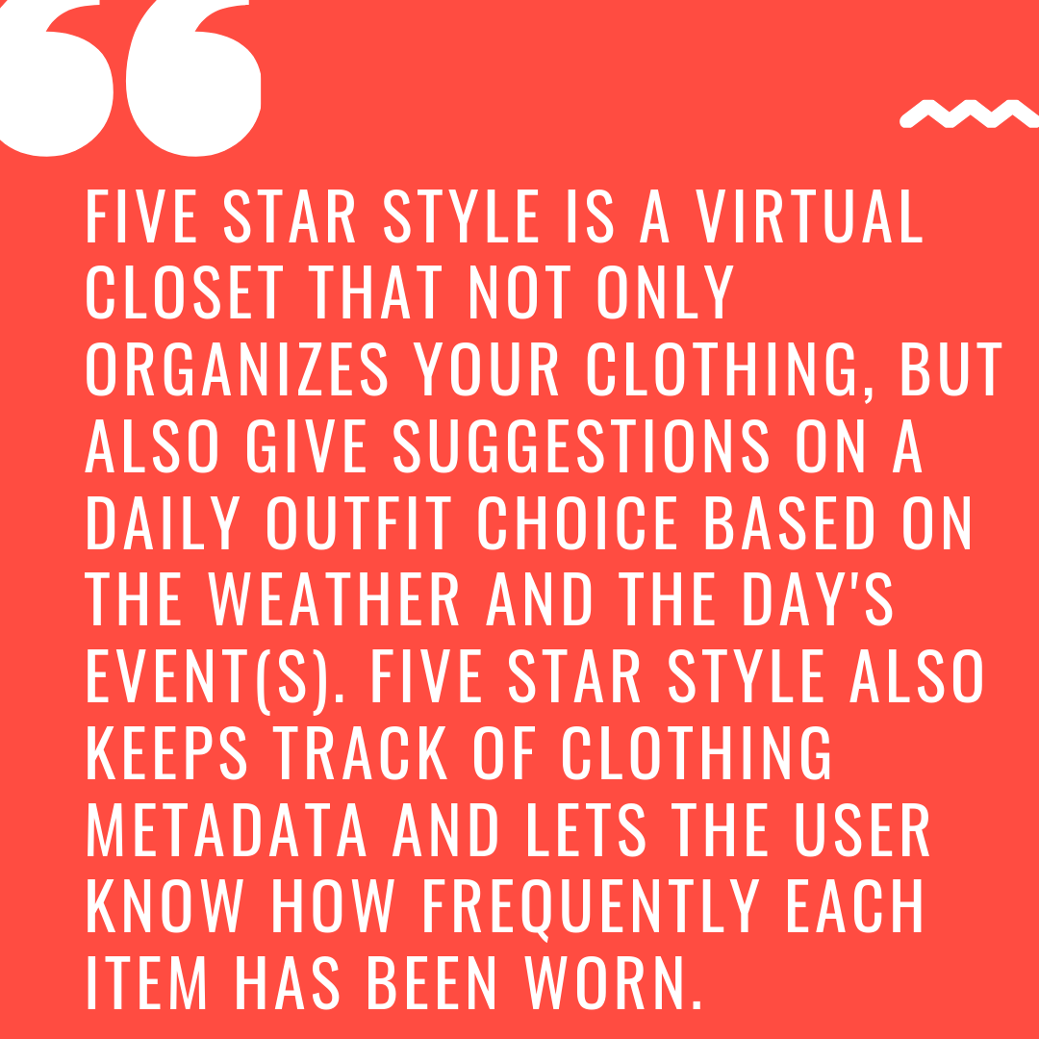
Notes:
Megan

Slide 3
Sprint Backlog
STORY
Database Structure
Settings Page
Add Cloud Vision API
User-Defined Labels
Populate Images on Item-Type Selection
Location Services
“Add to Closet” on Home Page
UI of several pages
ML Kit
Gender Neutral
J-unit Testing
ESTIMATED TIME
4 hours
2 hours
4 hours
6 hours
5 hours
2 hours
1 hour
1 hour
1 hour
1 hour
4 hours
PRIORITY
1
5
3
2
1
3
5
5
4
5
1
Notes:
Abigail

Slide 4
Reflections
Challenges faced
Added Lots of Functionality
Completed All Of Our goals
Learned More About Various APIs
J-Unit Tests
Better User Interface Than Sprint One
MLKit VS Cloud vision
Location services
Firebase Documentation
Image recognition Software
Fingerprint Of Application
Drawable Folders
Notes:
Autumn

Slide 5

Outfit Generator
More J-unit Testing
Closet Overview page
Keeping Track of most recently worn and least recently worn
Notes:
Caley

